Slide 1
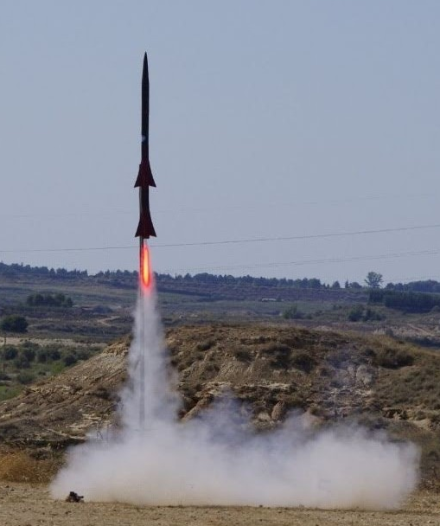

STUDY OF AMATEUR HIGH POWER ROCKET TRAJECTORIES
Bachelor’s degree in Aerospace Technology Engineering
Bachelor Final Thesis
By Alexis Leon Delgado​
Director / Co-director:
Arnau Miró Jané / David de la Torre Sangrà

Slide 2
TABLE OF CONTENTS
01
INTRODUCTION
02
03
04
SIMULATOR DEVELOPMENT AND PHYSICAL MODELS
RESULTS ANALYSIS
CONCLUSIONS AND FUTURE WORK

Slide 3
01
INTRODUCTION

Slide 4
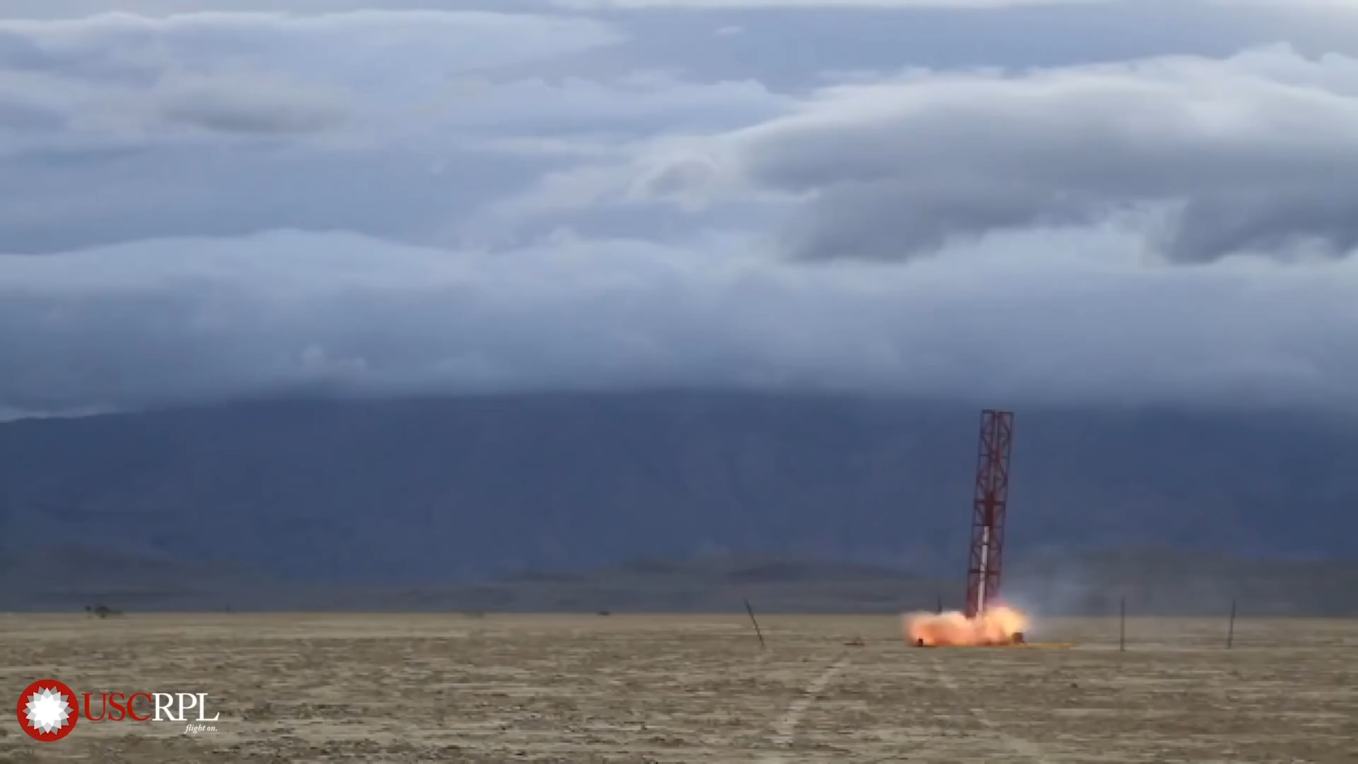
TABLE OF CONTENTS
Introduction
Simulator development and physical models
Results analysis
Conclusions and future work
Rocket flight entails security risks…
Video 1. Amateur High Power Rocket launch risks. Source: [1] (modified)

Slide 5
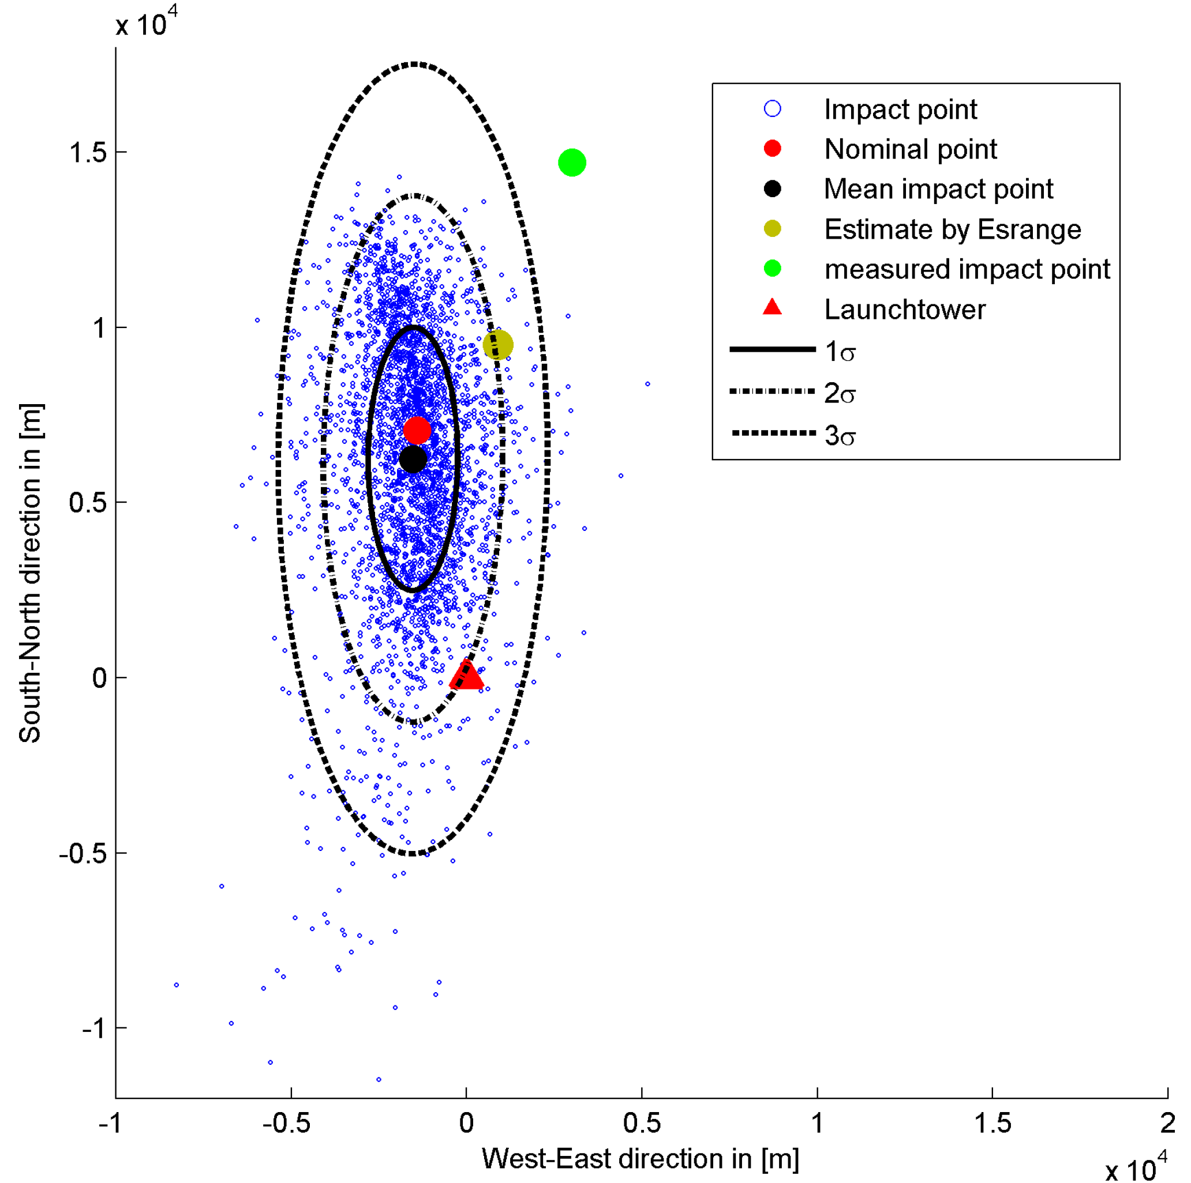
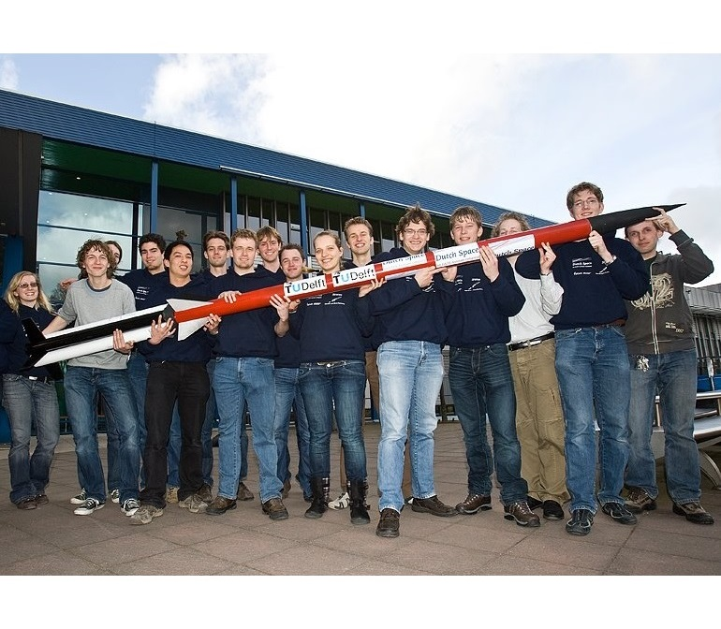
TABLE OF CONTENTS
Introduction
Simulator development and physical models
Results analysis
Conclusions and future work
Usefulness of trajectory simulation
Study of the operating limits
Splashdown zone estimation Launch safety area
Preventing casualties:
Figure 1. DARE’s Stratos I rocket. Source: [2]
Figure 2. Stratos I predicted impact points. Source: [3]

Slide 6

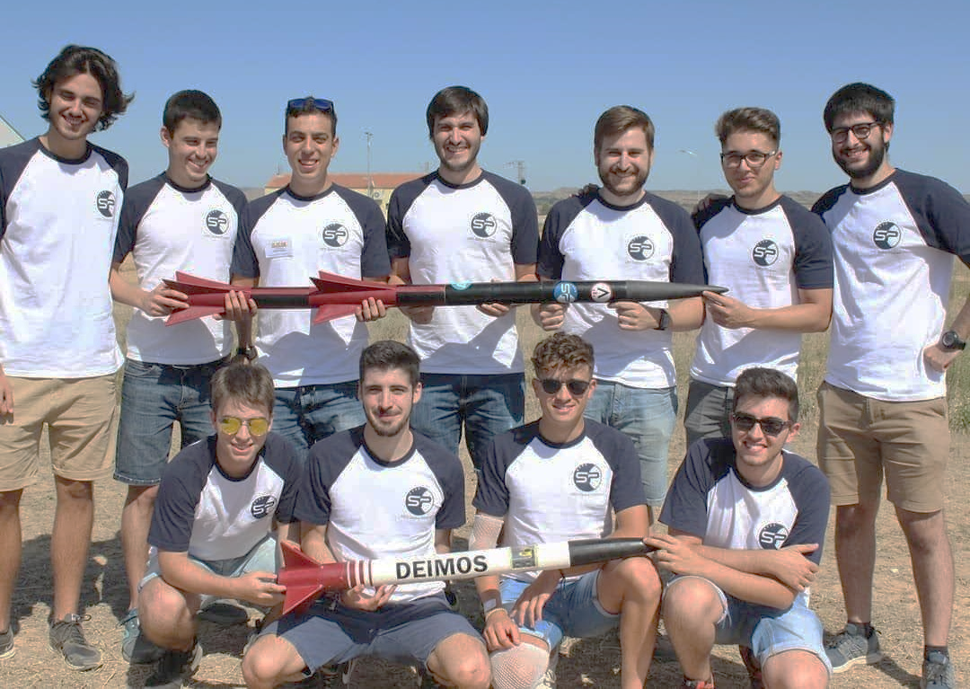
Application to Ares mission
Figure 3. UPC Space Program’s Ares team with Ares II and Deimos I rockets. Source: [4]
TABLE OF CONTENTS
Introduction
Simulator development and physical models
Results analysis
Conclusions and future work
Currently using Open Rocket. Features:
Basic simulations and physical models
No landing area prediction
Rocket Dynamics: Rocket Dynamics
Ares Simulator software
Study of Phobos rocket’s behaviour
To develop a rocket trajectory simulator for solid-propellant amateur High Power Rockets
6

Slide 7


Targeting EUROC participation
TABLE OF CONTENTS
Introduction
Simulator development and physical models
Results analysis
Conclusions and future work
Simulator compatibility
Software
Equations of motion
Rocket Dynamics coded in Python
Ares module (modular architecture)
Amateur HPR rockets (single or multistage)
3-DOF system of equations
Modeled for each flight phase
Flight models
Amateur propulsion
Monte Carlo study
Defined by flight phases
Triggered by flight events
Solid rocket motor thrust curves
Splashdown region estimation

Slide 8
SIMULATOR DEVELOPMENT AND PHYSICAL MODELS
02

Slide 9
Rocket Dynamics development
TABLE OF CONTENTS
Introduction
Simulator development and physical models
Results analysis
Conclusions and future work
Atmosphere
GUI
Config
Models
Core
MonteCarlo
Examples
Propulsion
Forces
pyRKIntegrator
Gravity
Tools
Common tasks
ARES MODULE
Update syntax from Python2 to Phyton3
Restructuring of scripts and functions
General bug fixing
Addition of new features for HPR rockets
In-depth modification or implementation from scratch of the modules

Slide 10
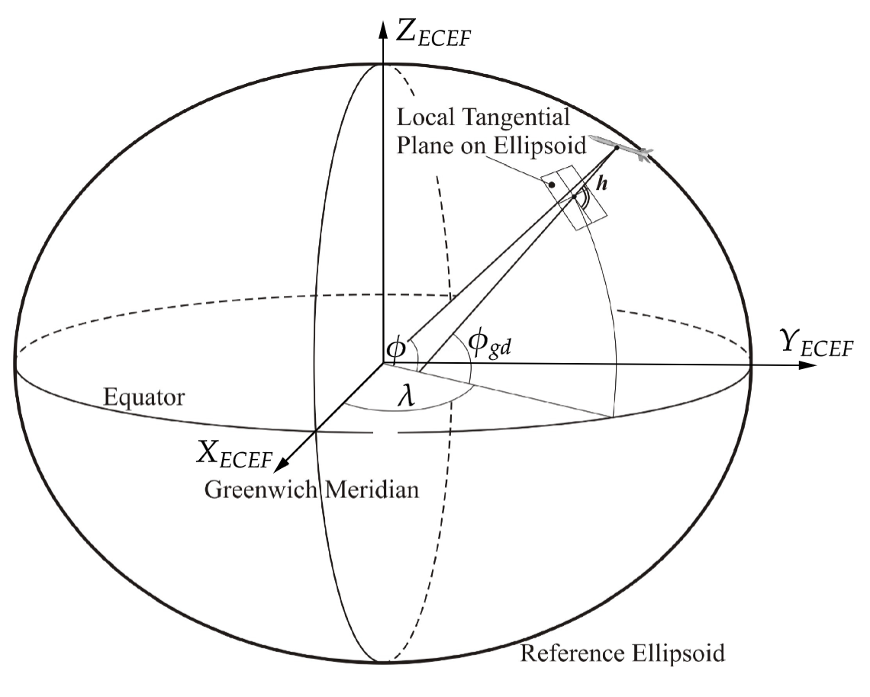
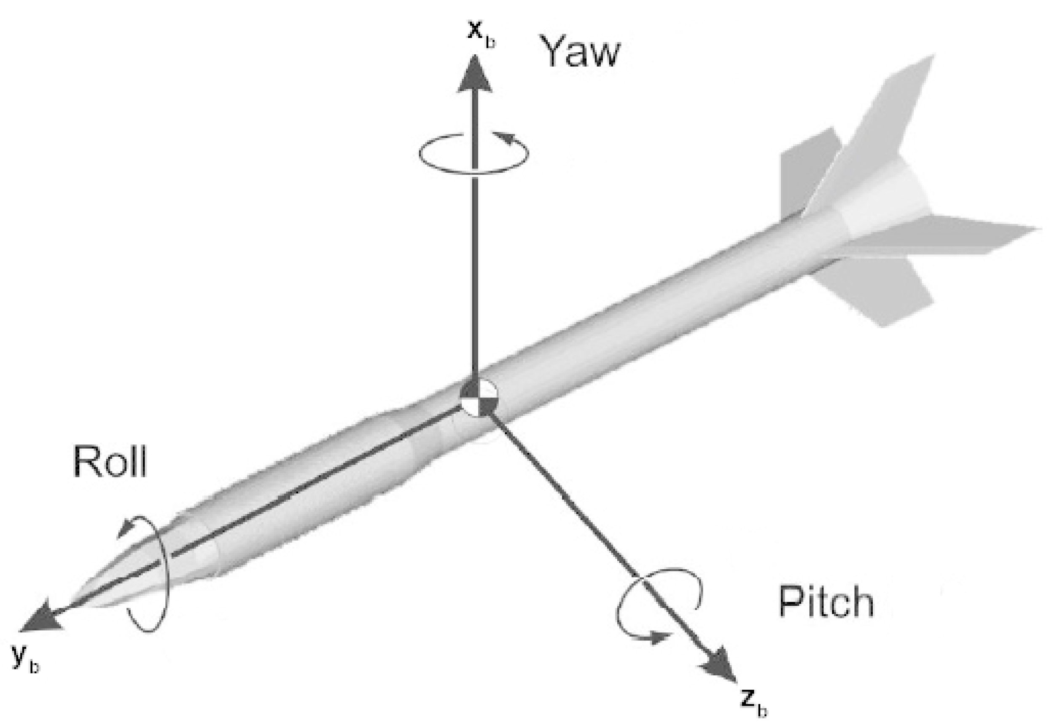
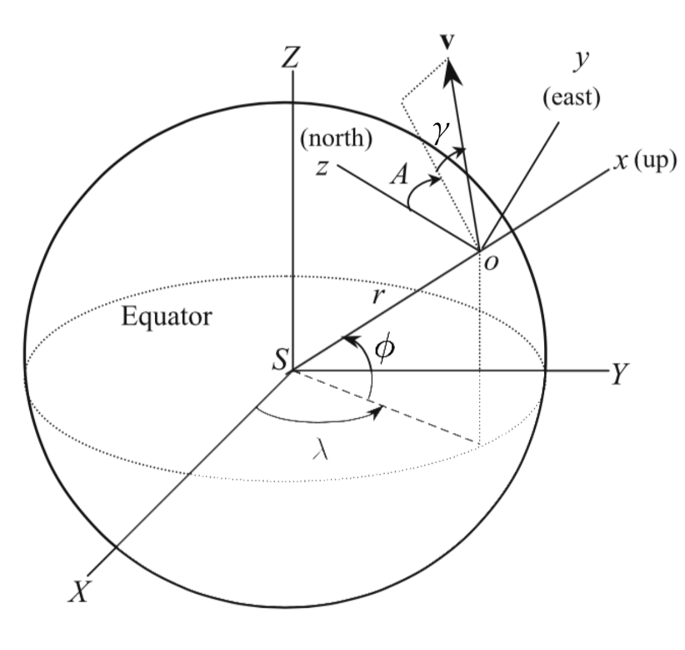
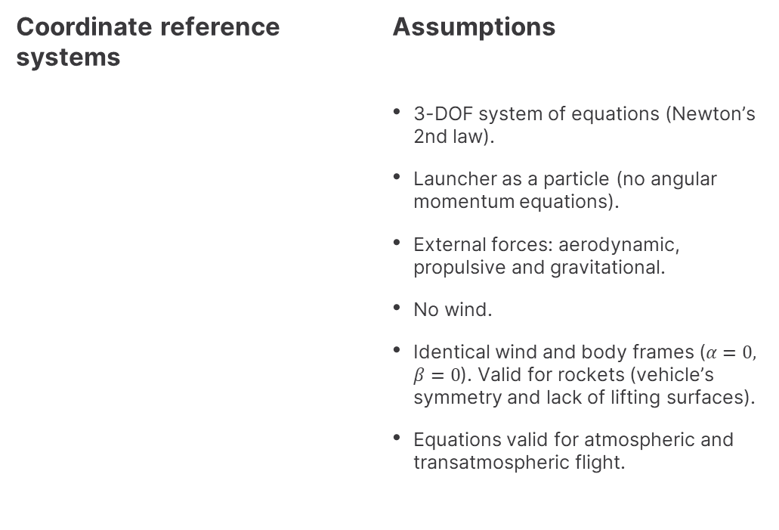
TABLE OF CONTENTS
Introduction
Simulator development and physical models
Results analysis
Conclusions and future work
General equations for suborbital flight
Coordinate reference systems
Assumptions
3-DOF system of equations (Newton’s 2nd law).
Launcher as a particle (no angular momentum equations).
External forces: aerodynamic, propulsive and gravitational.
No wind.
Identical wind and body frames ($α=0, β=0$). Valid for rockets (vehicle’s symmetry and lack of lifting surfaces).
Equations valid for atmospheric and transatmospheric flight.
ECEF
Body/wind
Figure 4. ECEF frame. Source: [5]
Figure 5. Body/wind frame. Source: [5]
East-North-Up (ENU)
Figure 6. East-North-Up frame. Source: [6]

Slide 11
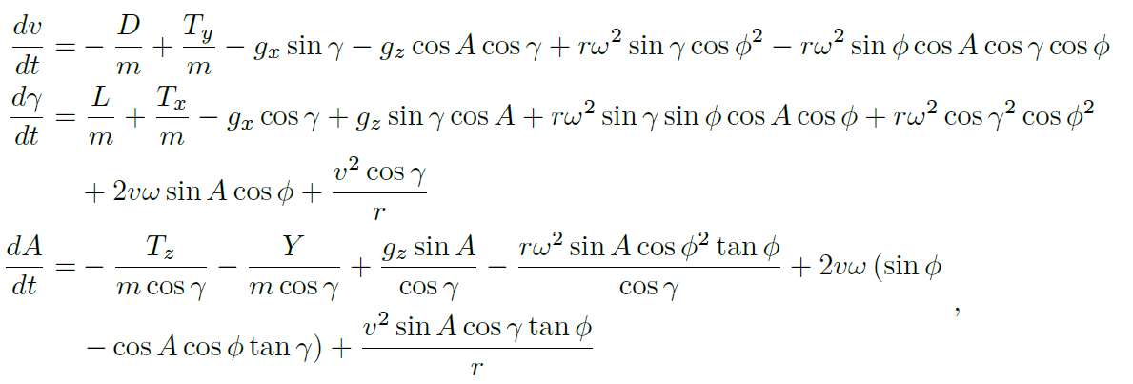
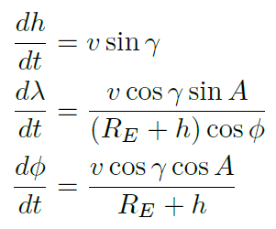
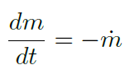
TABLE OF CONTENTS
Introduction
Simulator development and physical models
Results analysis
Conclusions and future work
General equations for suborbital flight
Equations of motion
3 dynamic equations
3 kinematic relations
1 mass relation

Slide 12
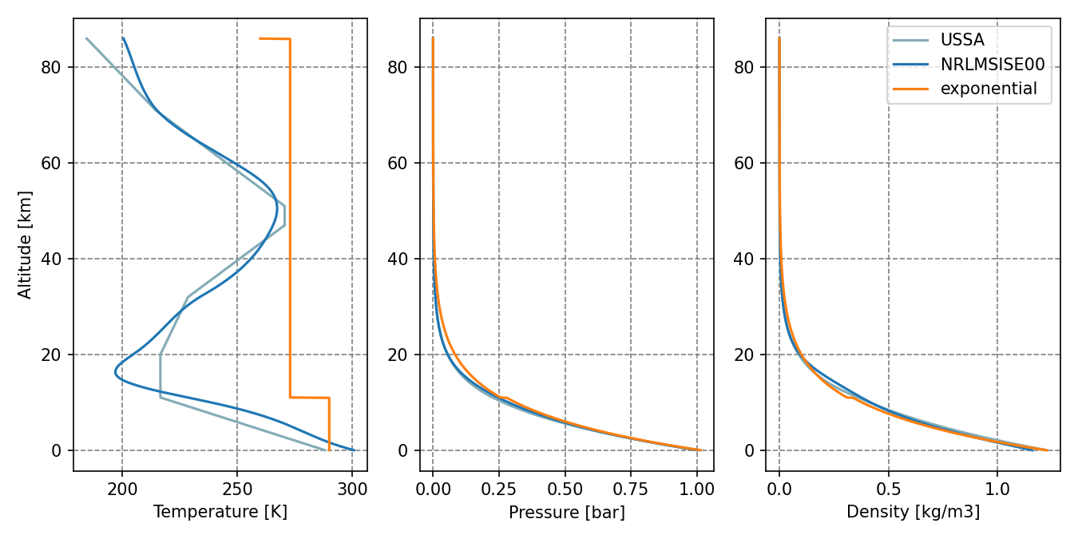
TABLE OF CONTENTS
Introduction
Simulator development and physical models
Results analysis
Conclusions and future work
Atmosphere module
Selection of a suitable model
Predominance of motion within the troposphere
Compatibility with amateur and non amateur rockets
U.S. Standard Atmosphere model
Figure 7. Atmospheric models comparison (USSA, NRML-SISE00, exponential)

Slide 13
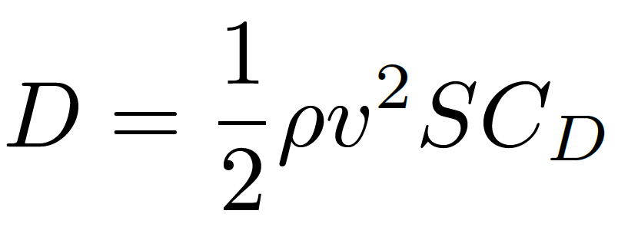
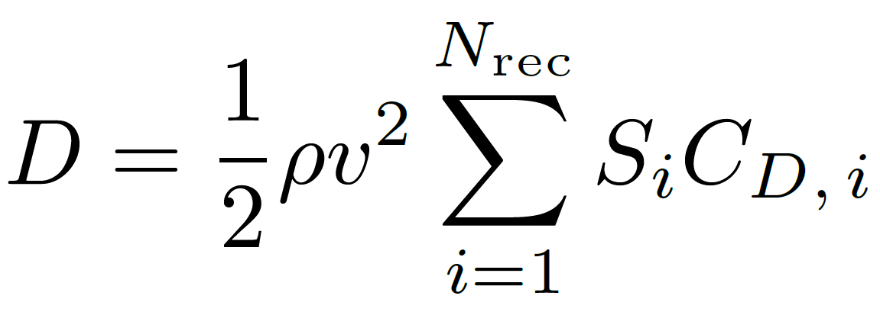
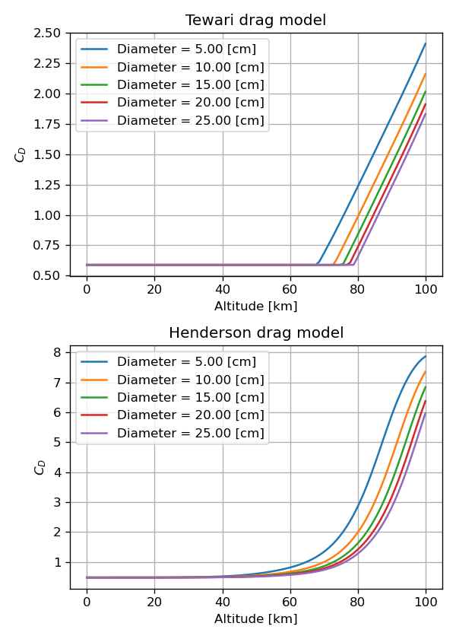
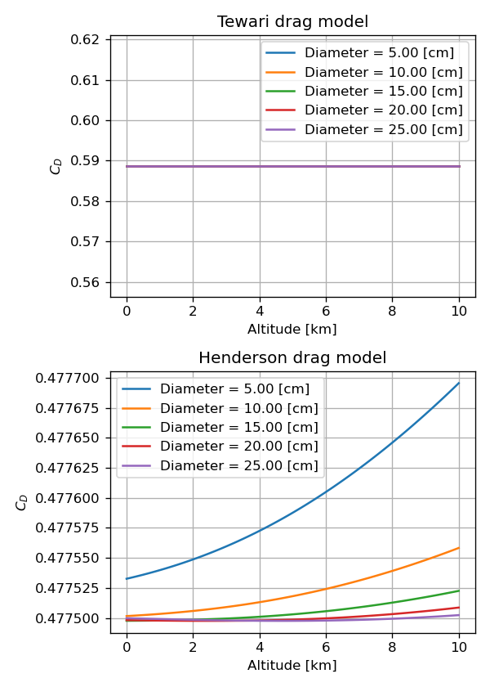
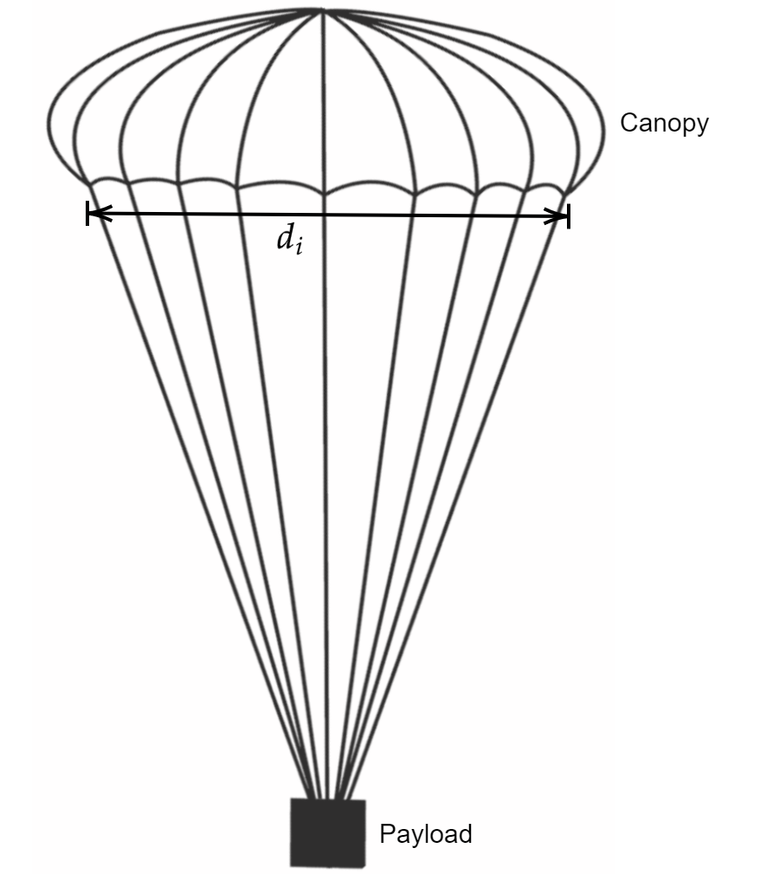
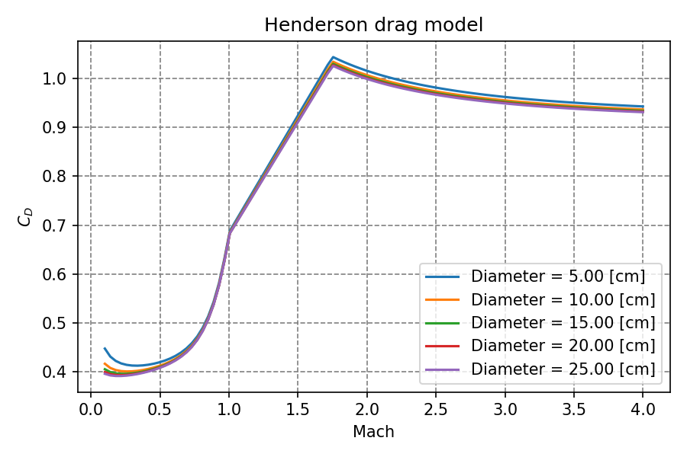
TABLE OF CONTENTS
Introduction
Simulator development and physical models
Results analysis
Conclusions and future work
Drag module
Rocket body drag
Recovery device drag
Henderson model
Figure 8. Parachute scheme. Source: [7] (modified).

Slide 14
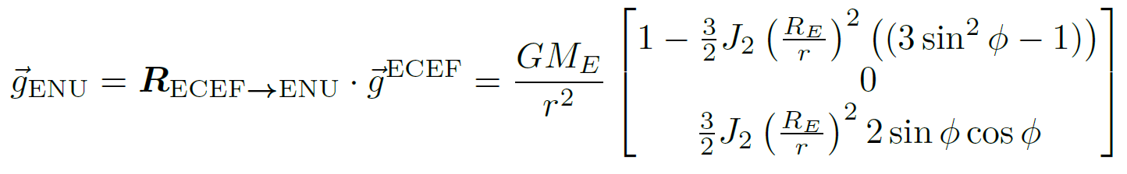
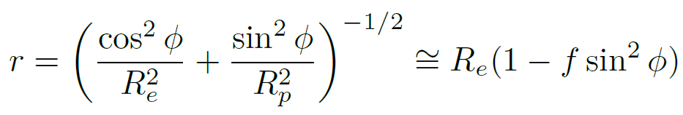
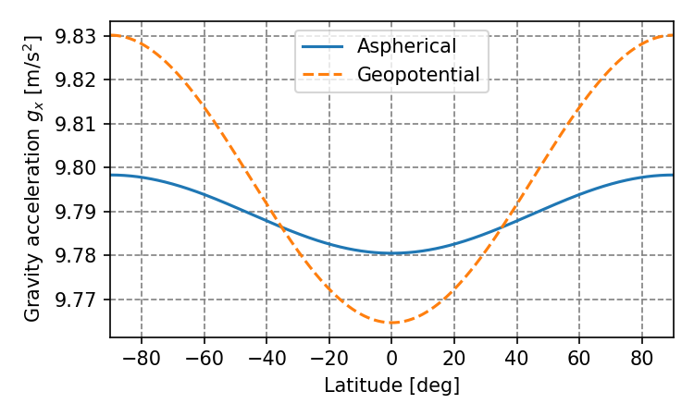
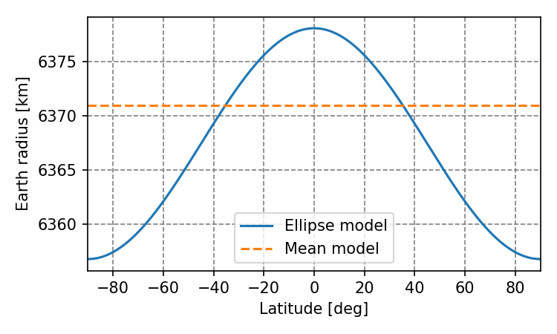
TABLE OF CONTENTS
Introduction
Simulator development and physical models
Results analysis
Conclusions and future work
Gravity module
Physical models
Aspherical gravity:
Ellipsoid radius (WGS84):
Figure 9. Gravity models comparison.
Figure 10. Radius models comparison.

Slide 15
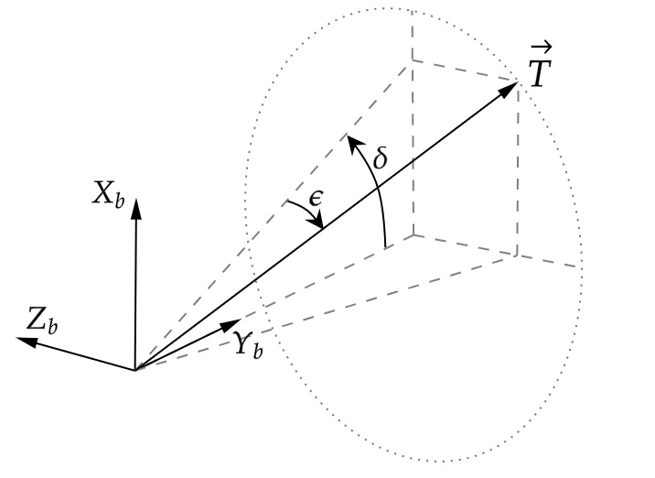
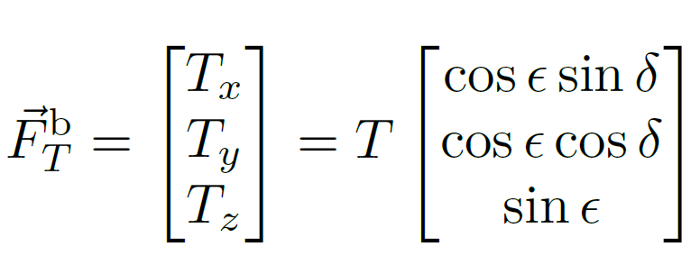
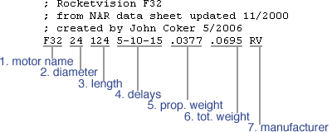
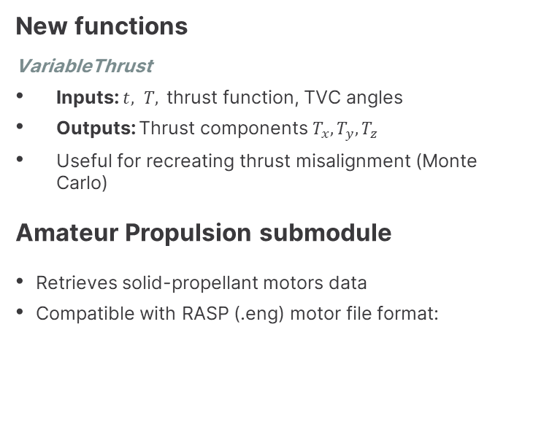
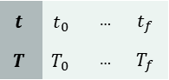
TABLE OF CONTENTS
Introduction
Simulator development and physical models
Results analysis
Conclusions and future work
Propulsion module
New functions
VariableThrust
Inputs: $t, T,$thrust function, TVC angles
Outputs: Thrust components $T_{x},T_{y},T_{z}$
Useful for recreating thrust misalignment (Monte Carlo)
Amateur Propulsion submodule
Retrieves solid-propellant motors data
Compatible with RASP (.eng) motor file format:
Figure 11. TVC force diagram and equation.
Header:
Data points:
$$t$$ | $$t_{0}$$ | … | $$t_{f}$$
$$T$$ | $$T_{0}$$ | … | $$T_{f}$$
Figure 12. RASP file header example. Source: [8]

Slide 16
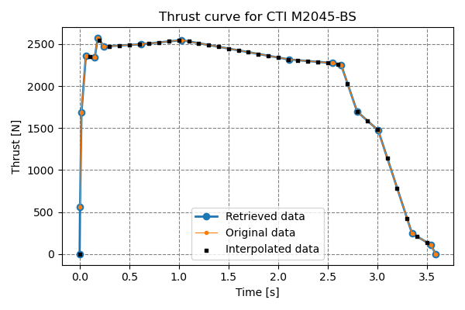
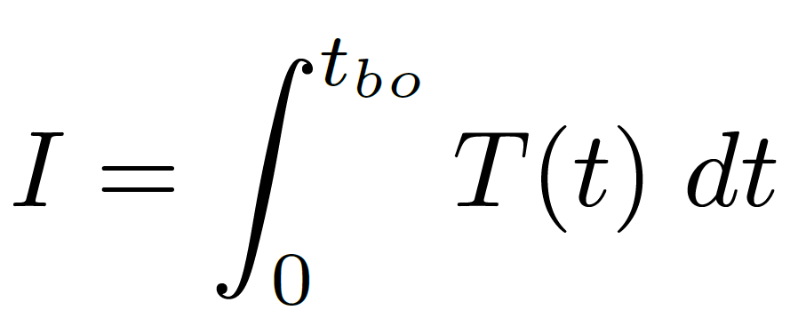
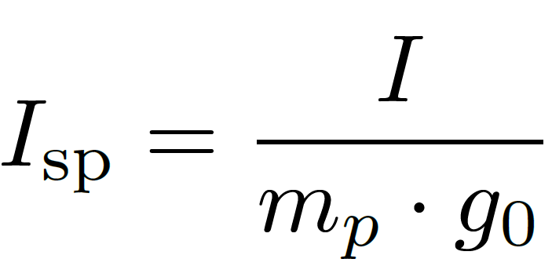
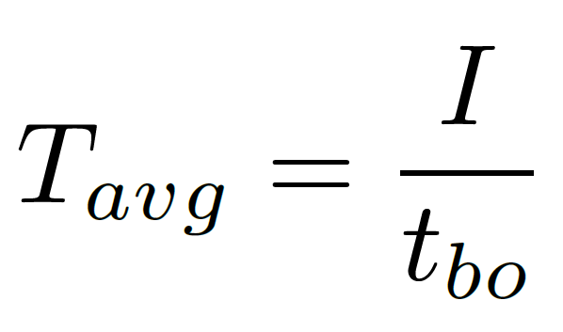
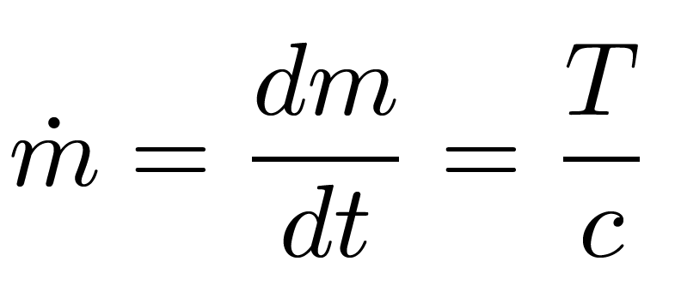
TABLE OF CONTENTS
Introduction
Simulator development and physical models
Results analysis
Conclusions and future work
Amateur Propulsion submodule
Motor data retrieval and processing
Thrust curve treatment and parameters computation:
Figure 13. Obtained thrust curve for the M2045 motor.

Slide 17
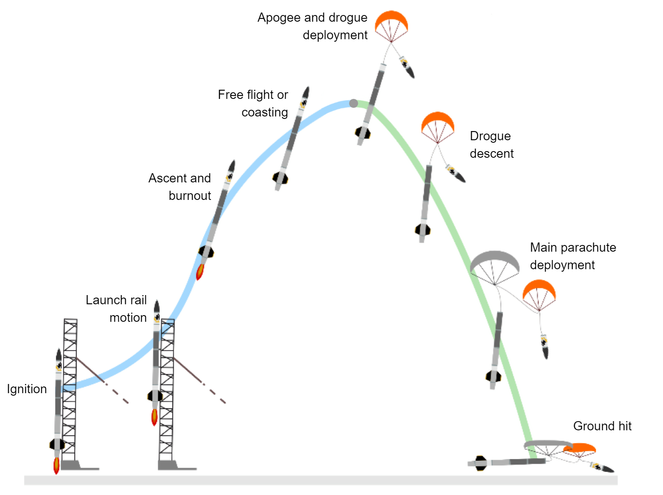
TABLE OF CONTENTS
Introduction
Simulator development and physical models
Results analysis
Conclusions and future work
Flight phases models and events
Flight phases
Launch rail motion:
Start: Ignition
End: Launch pad exit
Ascent and free flight:
Start: Launch pad exit
End: 1st recovery device ejection
Parachute descent:
Start: 1st recovery device ejection
End: Ground hit
Figure 14. Flight sequences of a High Power Rocket. Source: [9] (modified).

Slide 18
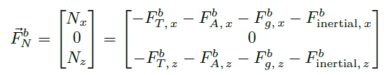
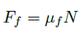
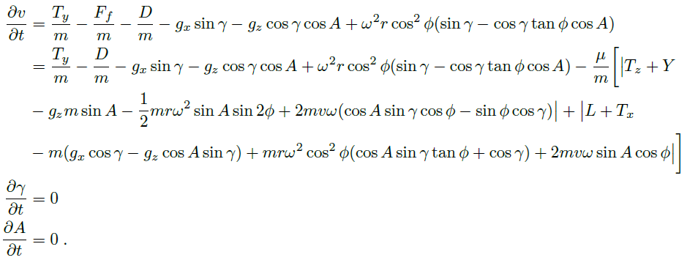
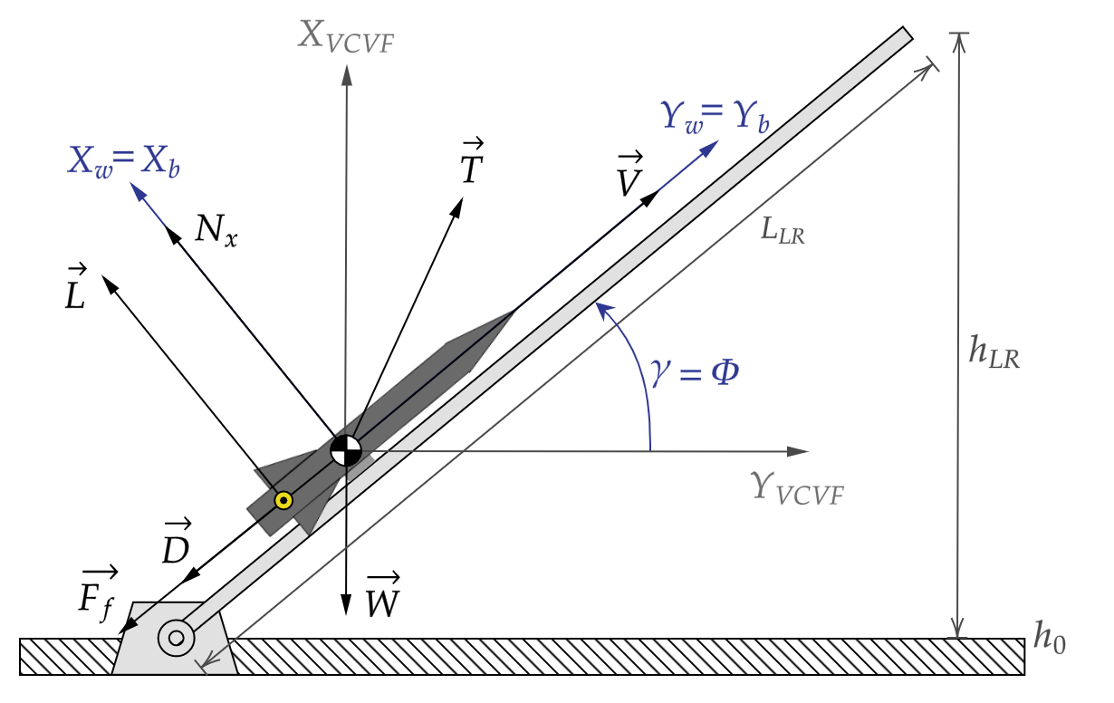
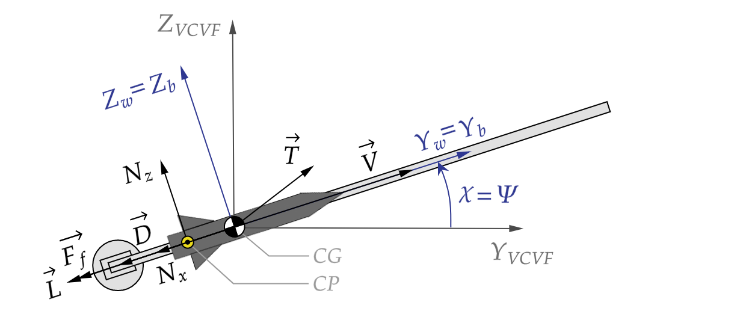
TABLE OF CONTENTS
Introduction
Simulator development and physical models
Results analysis
Conclusions and future work
1. Launch rail motion
Particularised equations of motion:
Linear motion (length, azimuth and elevation fixed)
Addition of friction force:
New dynamic equations:
Figure 15. Launch rail free body diagram.

Slide 19
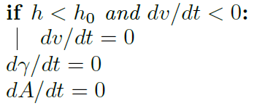
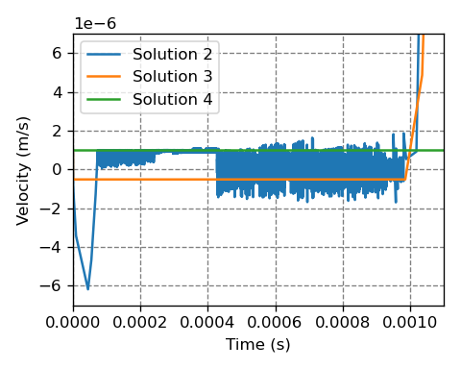
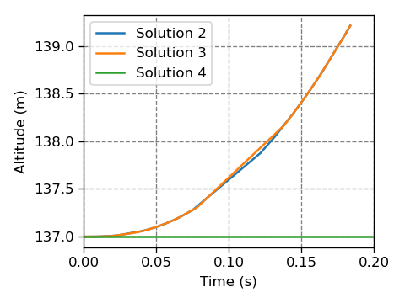
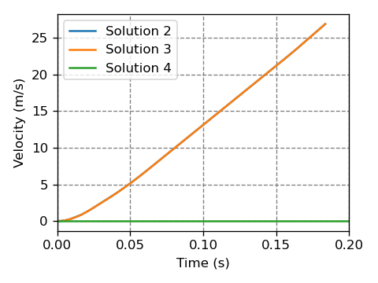
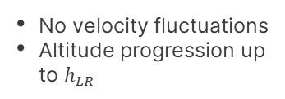

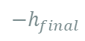
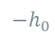
TABLE OF CONTENTS
Introduction
Simulator development and physical models
Results analysis
Conclusions and future work
1. Launch rail motion
Implementation:
Equations model as function:
ENU Amateur Launch Rail ENU_AM_LR
Velocity progression Altitude progression
Problem
Solution nº 3
Justification
Addition of physical ground
No velocity fluctuations
Altitude progression up to $h_{LR}$
$${−h}_{final}$$
$$h_{Launch Rail}$$
$${−h}_{0}$$
Figure 16. Launch rail motion validation graphs.

Slide 20
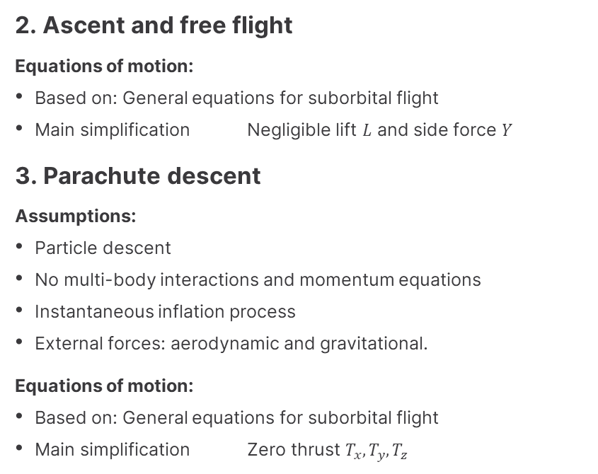
TABLE OF CONTENTS
Introduction
Simulator development and physical models
Results analysis
Conclusions and future work
2. Ascent and free flight
Equations of motion:
Based on: General equations for suborbital flight
Main simplification Negligible lift $L$ and side force $Y$
3. Parachute descent
Assumptions:
Particle descent
No multi-body interactions and momentum equations
Instantaneous inflation process
External forces: aerodynamic and gravitational.
Equations of motion:
Based on: General equations for suborbital flight
Main simplification Zero thrust $T_{x},T_{y},T_{z}$

Slide 21
RESULTS ANALYSIS
03
Simulation validation
Monte Carlo study

Slide 22
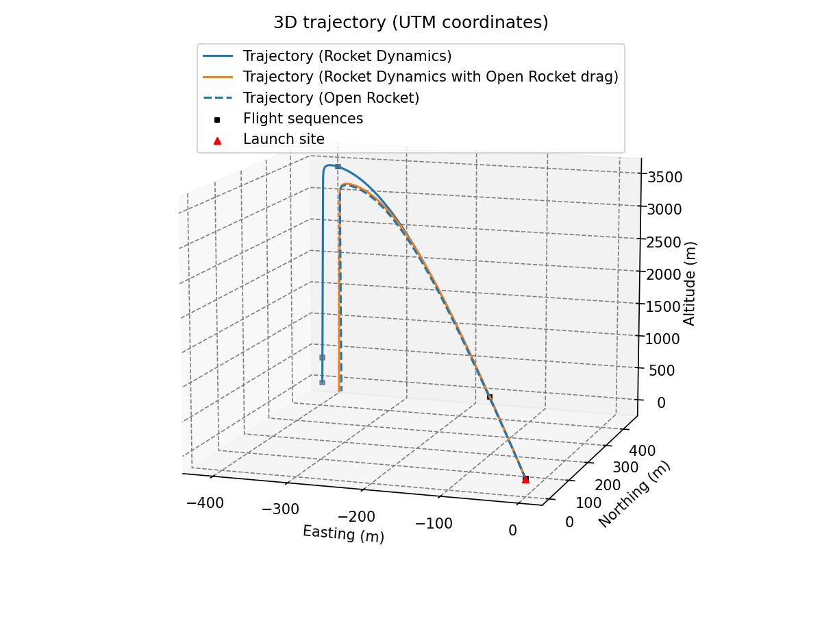
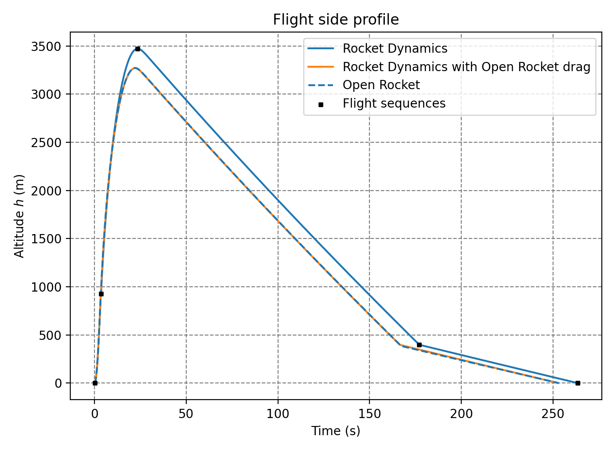
Simulation validation
TABLE OF CONTENTS
Introduction
Simulator development and physical models
Results analysis
Conclusions and future work
1. Comparison with Open Rocket
Phobos rocket
317.5º
Launch azimuth
84.6º
Launch angle
Relative error
Trajectory
Flight profile
RD
3471.64
602.53
Apogee altitude (m)
6.1%
11.2%
Impact point (m)
OR
3271.10
541.85
Figure 17. Phobos rocket trajectory.
Figure 18. Phobos flight profile.

Slide 23
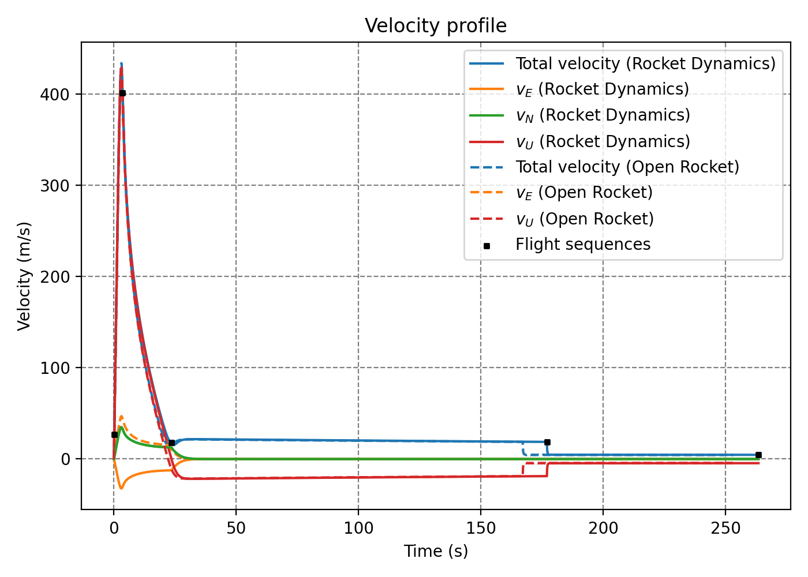
Simulation validation
TABLE OF CONTENTS
Introduction
Simulator development and physical models
Results analysis
Conclusions and future work
1. Comparison with Open Rocket
Velocity and losses
Relative error
RD
427.89
389.37
Max. velocity (m/s)
1.3%
3.4%
Drag losses (m/s)
OR
433.48
403.04
Figure 19. Phobos velocity profile.

Slide 24


Simulation validation
TABLE OF CONTENTS
Introduction
Simulator development and physical models
Results analysis
Conclusions and future work
2. Comparison with experimental data
Ares II rocket
0.0º
Launch azimuth
84.6º
Launch angle
Relative error
Trajectory
Flight profile
RD
561.24
140.52
Apogee altitude (m)
20.9%
8.2%
Impact point (m)
Exp.
464.17
129.85
Figure 20. Ares II rocket trajectory.
Figure 21. Ares II flight profile.

Slide 25


Simulation validation
TABLE OF CONTENTS
Introduction
Simulator development and physical models
Results analysis
Conclusions and future work
2. Comparison with experimental data
Velocity
Relative error
RD
100.82
Max. velocity $V_{u}$ (m/s)
1.5%
Exp.
99.30
Figure 22. Ares II velocity profile.

Slide 26






Monte Carlo study
TABLE OF CONTENTS
Introduction
Simulator development and physical models
Results analysis
Conclusions and future work
Algorithm development
Stochastic parameters
Splashdown zone estimation
Ellipse fitting (bivariate normal distr.) Semi-axes = standard deviations $σ_{x}^{′}, σ_{y}′$
Parameters selection
Computation of stochastic parameters
Random noise sampling
$$γ_{0}, A_{0}, F_{avg}, δ, ε, C_{D}^{rec}…$$
Figure 23. Bivariate normal distribution. Source: [10] (modified).
Figure 24. Confidence ellipse properties.

Slide 27


Monte Carlo study
TABLE OF CONTENTS
Introduction
Simulator development and physical models
Results analysis
Conclusions and future work
Simulation results
Splashdown region
1750 impact points
1$σ$ ellipse (68% prob.)
Semi-major axis:
$σ_{x}=110.93 m$
Semi-minor axis:
$σ_{y}=38.20 m$
Ellipse rotation:
$A={311.73}^{∘}$
Figure 25. Impact dispersion and splashdown zone.

Slide 28






Monte Carlo study
TABLE OF CONTENTS
Introduction
Simulator development and physical models
Results analysis
Conclusions and future work
Simulation results
Phobos’ objective parameters compliance
Apogee altitude (m)
Computed: $3472.80±45.49$
Objective: $3000.00±30\%$
Max. acceleration (G)
Computed: $18.79±0.19$
Objective: $<100$
Launch rail exit velocity (m/s)
Computed: $26.91±0.19$
Objective: $>20.00$
Parachute deploy. vel. (m/s)
Computed: $18.77±0.21$
Objective: $∈(23, 46)$
Maximum Mach
Computed: $1.27±0.01$
Objective: $None$
Impact velocity (m/s)
Computed: $4.56±0.05$
Objective: $<9.00$

Slide 29
CONCLUSIONS AND FUTURE WORK
04

Slide 30
Simulator development
Physical and mathematical models
Validation and Monte Carlo study
TABLE OF CONTENTS
Introduction
Simulator development and physical models
Results analysis
Conclusions and future work
CONCLUSIONS
Equations of motion deduction
Flight phases modeling
Rocket Dynamics restructuring in Python
Ares module creation (Amateur Propulsion, flight models and events…)
Similar performance between Rocket Dynamics and Open Rocket
Splashdown prediction and objectives compliance
FUTURE WORK
Inclusion of a wind model
Physical model upgrade
6-DOF equations system
Momentum equations
Atmospheric models (ERA5 or WRF)
Study wind influence
30

Slide 31

THANKS
Does anyone have any questions?

Slide 32
References
[1] USC Rocket Propulsion Laboratory. (2019). First all-student rocket to reach space | Traveler IV Launch - YouTube. https://www.youtube.com/watch?v=Y5j74uv427g
[2] DARE TU Delft. (2009). Stratos I launch https://www.facebook.com/daretudelft/photos/844879312240172
[3] Engelen, F., & Mooij, E. (n.d.). Quantitative risk analysis of rocket trajectories. https://www.researchgate.net/publication/283673953_Quantitative_risk_analysis_of_rocket_trajectories
[4] Home - UPC Space Program. (n.d.). https://upcprogram.space/en/
[5] Persson, O., Stamminger, A., & Hellmann, H. (2007). Rexus Manual (tech. rep.). http://rexusbexus.net/wp-content/uploads/2018/11/RX_UserManual_v7-16_24Oct18.pdf
[6] Tewari, A. (2007). Atmospheric and space flight dynamics : modeling and simulation with MATLABand Simulink / Ashish Tewari. Birkhäuser, https://discovery.upc.edu/iii/encore/record/C__Rb1371374__Satmospheric %20flight%20dynamics%20tewari__Orightresult__U__X2?lang=cat
[7] Guglieri, Giorgio. (2012). Parachute-Payload System Flight Dynamics and Trajectory Simulation. International Journal of Aerospace Engineering. 2012. 10.1155/2012/182907. https://www.researchgate.net/publication/258382257
[8] Thrustcurve.org. (n.d.). RASP File Format • ThrustCurve. https://www.thrustcurve.org/info/raspformat.html
[9] Waterloo Rocketry. (2018). Unexploded Ordnance Hybrid Rocket (tech. rep.). University of Waterloo. Waterloo, Canada. https://www.waterloorocketry.com/pdfs/2018%7B_%7Dproject%7B_%7Dreport.pdf
[10] File:MultivariateNormal.png - Wikimedia Commons. (n.d.). https://commons.wikimedia.org/wiki/File:MultivariateNormal.png

Slide 33
Support slides
05

Slide 34
Scope
To study and simulate the trajectories of unguided solid-propellant amateur rockets
To implement the Rocket Dynamics software and the Ares module in Python
To develop and implement the physical model of the launch, ascent and parachute descent phases for amateur rockets.
To cover the main amateur rocketry solid propulsion options.
To predict and display the rocket’s splashdown area with confidence bounds using the Monte Carlo method.
To validate the software by means of experimental data of an Ares mission rocket launch.

Slide 35
Requirements
Compatibility
Equations of motion
Amateur rocketry Real space launchers Single or multistage rockets
System of minimum 3 DOF (according to EUROC)
Architecture
Splashdown region
Modular structure (RD software)
Displayed with confidence bounds
Amateur propulsion
Flight simulation
Solid rocket motor thrust curves
Defined by flight phases Separated by flight events

Slide 36
Ares module implementation
Major updates:
General equations for suborbital flight
Amateur Propulsion submodule
Flight phases models and events
Input configurations and their processing
Launch simulations configuration

Slide 37

TABLE OF CONTENTS
Introduction
Simulator development and physical models
Results analysis
Conclusions and future work
Ascent, free flight and parachute descent implementation
A single function to define the model of equations:
Events
EventLaunchRailEnd Stops integration at launch rail exit
EventApogee Stops integration at apogee
EventHeight Stops integration at a specific altitude
EventStopAtGround Stops integration at ground hit
ENU_AM_Ascent_Freeflight_Descent
Variables and data retrieval
Planet, gravity and atmosphere data retrieval
Aerodynamic coefficients and forces computation: $D, L, Y$
Thrust force and mass flow computation: $T_{x}, T_{y}, T_{z}, \dot{m}$
Dynamic equations computation: $dv/dt,dγ/dt,dA/dt$
Kinematic equations computation: $dh/dt,dλ/dt,dφ/dt$
1
2
3
4
5
6

Slide 38


Software validation
Open-source comparison
Experimental comparison

Slide 39

Monte Carlo results

